Slide 1
45 Day Check-in and Preparing for Budget Development
Dunbar ES GO Team Business Meeting #3
11-30-23

Slide 2
Agenda
Continuous Improvement Plan
45 Day Check-in
Fall to Winter MAP Data Discussion
Review of Strategic Plan and priorities progress
Strategic Plan Updates
Preparing for the Budget Development
Rank Strategic Priorities

Slide 3
Timeline for GO Teams
You are HERE
Fall 2021
GO Team Developed 2021-2025 Strategic Plan
1
Summer 2023
School Leadership completed Needs Assessment and defined overarching needs for SY23-24
2
August 2023
School Leadership completed 2023-2024 Continuous Improvement Plan
3
Sept. – Dec. 2023
Utilizing current data, the GO Team will review & possibly update the school strategic priorities and plan
4
Before Winter Break
GO Team will take action (vote) on the school’s strategic plan and vote on the ranked strategic plan priorities for SY24-25 budget discussions.
5
1
2
3
4
5

Slide 4
Continuous Improvement Plan

Slide 5
Quarterly CIP Check-in
As part of the Continuous Improvement process, all APS schools are completing a quarterly check-in for the Continuous Improvement Plans.
Questions to Consider
Based on our year long CIP plan, what are the actions that the school has already completed?​
What data supports the completion of an action step and success criteria (both implementation and student achievement)?

Slide 6
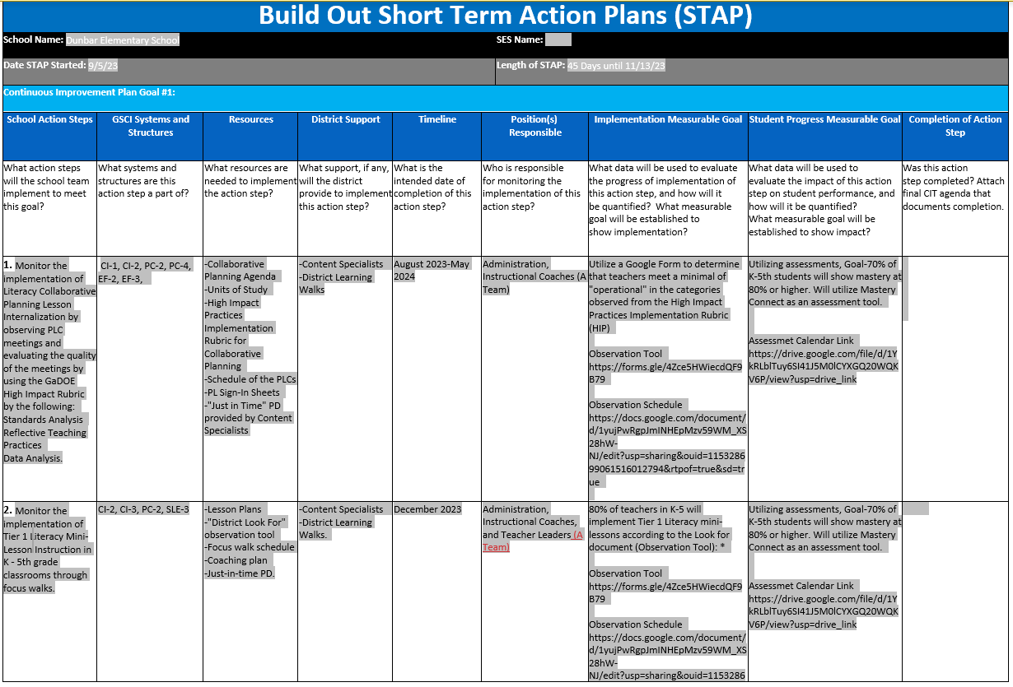

Slide 7
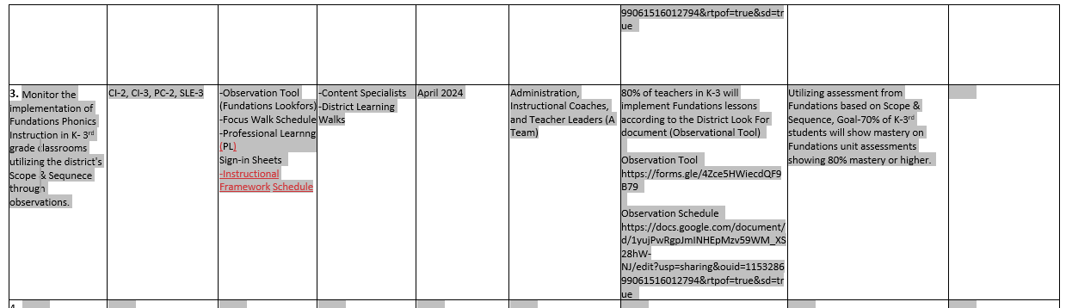

Slide 8
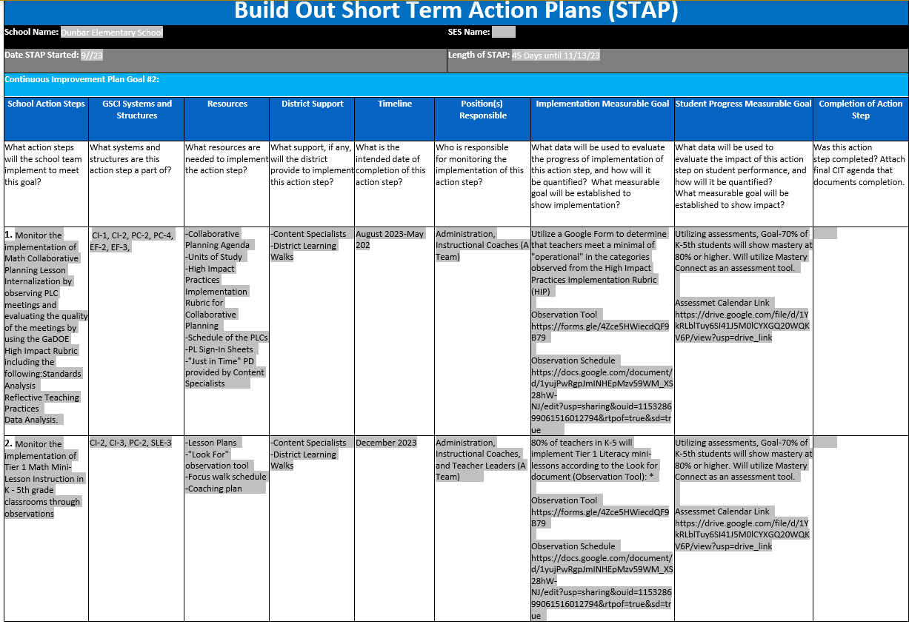

Slide 9
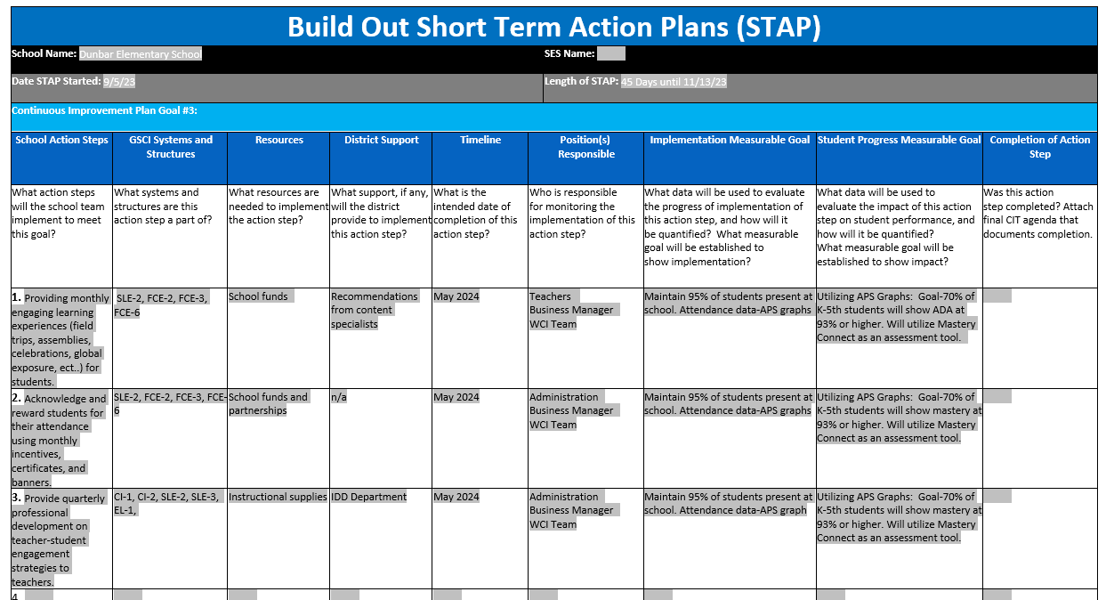

Slide 10
Data Discussion

Slide 11
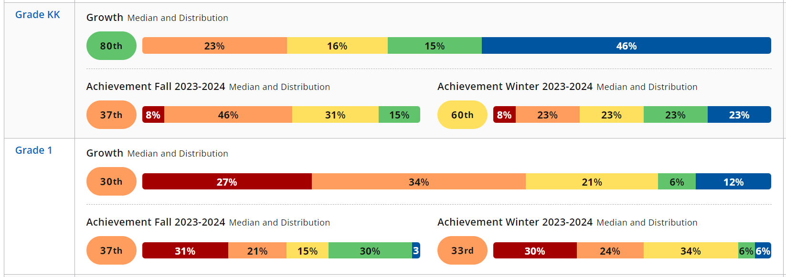
Fall –Winter MAP Results
ELA (Kdg & 1st )

Slide 12
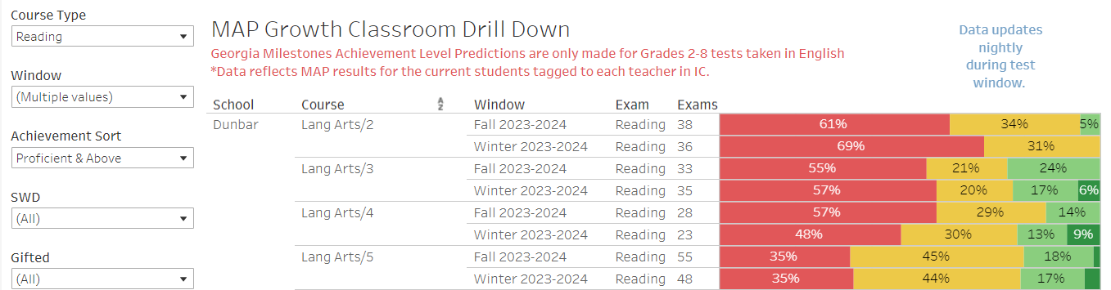
Fall –Winter MAP Results
ELA (2nd-5th )

Slide 13
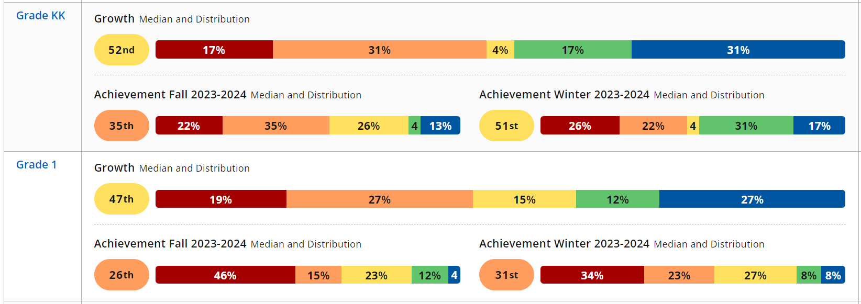
Fall –Winter MAP Results
MATH (Kdg & 1st)

Slide 14
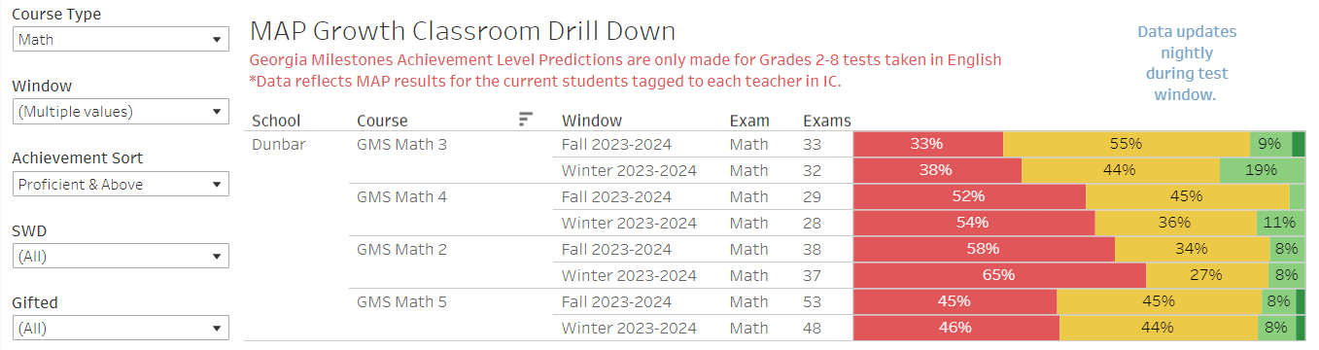
Fall –Winter MAP Results
MATH (2nd -5th )

Slide 15

GO Team Discussion:
Data Protocol
What do you notice?
What are your wonderings?
What additional questions do you have?

Slide 16
Strategic Plan Progress

Slide 17
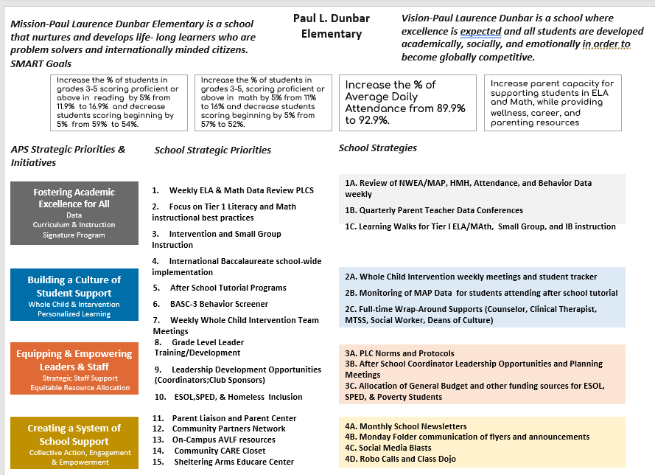
Our
Strategic
Plan

Slide 18
Activity & Discussion
GO TEAM DISCUSSION: Review the priorities and goals in your strategic plan and reflect on if the expected progress is being made. These guiding questions will help you determine what, if any, updates are needed for your school’s strategic plan.
What progress has been made towards the priorities identified in our Strategic Plan? What evidence/data do we have?
Based upon available data, are there any other adjustments we need to make to the Strategic Plan?

Slide 19
Updates to the
Strategic Plan
Enter all changes/updates to your plan – be sure to include accountability measures, as appropriate.

Slide 20
Action on the Updated Strategic Plan
The GO Team needs to TAKE ACTION (vote) on its updated Strategic Plan. After the motion and a second, the GO Team may have additional discussion. Once discussion is concluded, the GO Team will vote.

Slide 21
Preparing for
Budget Development

Slide 22
Discussion
Strategic Plan Priority Ranking
In preparation for the 2024-2025 Budget Development (January–March 2024), the GO Team needs to rank its Strategic Plan Priorities. Use the next slide to capture the priority ranking.

Slide 23
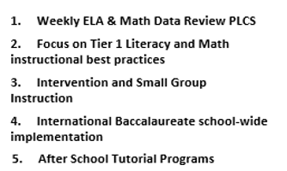
Strategic Plan
Priority Ranking
Insert the school’s priorities from Higher to Lower
Higher
2.
3.
4.
5.
Lower

Slide 24
Action on the
Strategic Plan Priorities
The GO Team needs to TAKE ACTION (vote) on its ranked Strategic Plan Priorities. After the motion and a second, the GO Team may have additional discussion. Once discussion is concluded, the GO Team will vote.

Slide 25
Where we’re going
At our next meeting we will begin the discussion of the 2024-2025 budget.
Let me or the Chair know of any additional information you need for our future discussion.

Slide 26
Thank you

